Slide 1
Type equality
Programming Language Design and Implementation
(4th Edition)
by T. Pratt and M. Zelkowitz
Prentice Hall, 2001
Section 6.4

Slide 2
Safe expressions
Type checking: Want languages to only permit safe expressions:
f: x → y.
f is a safe expression if f(a) = b implies a ε x. [That is, it is impossible to create an improper function call.]
+: int x int → int
2+3 = int result - all arguments are safe
But what about /:float x float → float?
3/0?

Slide 3
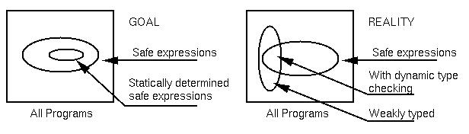
Strong types
A language is strongly typed if only safe expressions can be expressed in the language (i.e., results must be defined for that data type).
E.g., char a, b, c;
c = a+b; ⇐ Not safe since a+b can be > 255
But long a, b, c;
c = a+b; ⇐ Safe since overflows will halt execution
A[I] ⇐ Safe if dynamic checking of subscripts is performed
A language is weakly typed if it accepts expressions that are not safe.

Slide 4
Equality
Two aspects of equality:
When do 2 objects have the same value?
When are two types the same?
We will look at the first of these (equality of values)
Define a new language: assign 2+1 to A
Is A equal to 3?
This is ambiguous as stated, although true for most languages studied so far.
Need signature for assign and type for A
If A is integer, then coersion forces 2+1 to be 3.
If A is type code, then 2+1 is expression to be evaluated
SNOBOL4 and Prolog operate this way. We will look at Prolog later.

Slide 5
Equality of data objects
For primitive data types equality is bit-level equality:
int x; int y;
float x; float y;
x=y if they have same bit values
But look at user types:
type rational = record
numerator: real;
denominator: real
end;
var A, B: rational;
if A=B then ... ⇐ When is this true?
True if: A.numerator=B.numerator and A.denominator=B.denominator
or A.numerator/A.denominator = B.numerator/B.denominator
There is no way for compiler to understand that rational means the usual mathematical concept of rational numbers. Equality must be defined, not coersed.

Slide 6
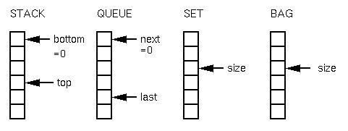
Why a need for separate definition of equality
Consider the following 4 data types and their representations:
All can be defined as:
struct {int size;
int storage[100];}

Slide 7
Meaning of A=B
What does A=B mean for each data type?
stack: A.size = B.size
For all i, A.storage[i]=B.storage[i]
queue: A.size = B.size
For all i, A.storage[i]=B.storage[i]
⬅ 다르게는???
set: A.size = B.size
All A.storage[i] differ
For all i, some j, A.storage[i]=B.storage[j]
(i.e., B.storage is a permutation of A.storage)
bag: A.size = B.size
B.storage is a permutation of A.storage
So equality of user types is a complex issue that cannot be built into the operator by the language definition (effectively).

Slide 8
Type equivalence
Are X and Y the same type?
type A = ...; type B = ...; A X; B Y;
Name equivalence: X and Y are name equivalent if they are defined using the same name identifier:
In Pascal: var X: array [1..10] of integer;
Y: array [1..10] of integer;
are not the same type, but:
type arr = array [1..10] of integer;
var U: arr; V: arr;
are the same type.
Structural equivalence: X and Y have the same storage
representation:
x: record
a: real; b: integer end
y: record
m: real; n: integer end
x and y have structural equivalence

Slide 9
C type equivalence
C uses name equivalence
Explain the following:
#define A struct {int M} typedef struct {int M} A;
A X, Y; A X, Y;
A Z; A Z;
X=Y is legal X=Y is legal
X=Z is an error X=Z is legal
Although many C compilers will accept both definitions

Slide 10
Type Definitions with Parameters
Ada:
type Section(MaxSize: Integer) is
record
Room: integer;
Instructor: integer;
ClassSize: integer range 0 .. Maxsize;
ClassRoll: array(1 .. Maxsize) of Student_ID;
end record;
X: Section(100); Y: Section(25);
ML:
signature OrderedItem =
sig
type elem
var lessthan elem*elem-> bool
end;

